Slide 1

Occupations in Pakistan

Slide 2



Group Members:
Muhammad Umer Farooq
Muhammad Taha Baig
Muhammad Tayyab
4167-FBAS-BSCS-F19
4184-FBAS-BSCS-F19
4183-FBAS-BSCS-F19

Slide 3
Introduction:
Pakistan is a diverse country with a wide range of occupations.
Occupations reflect the country's economy and workforce.
Today, we will explore the major occupations in Pakistan.

Slide 4
There are Ten major Occupations in Pakistan are as follows
Agriculture
Textile Industry
Manufacturing
Services Sector
Construction
Transportation
Government Services
Armed Forces
Education and Research
Freelancing and Entrepreneurship

Slide 5


1. Agriculture:
Pakistan's economy is largely agrarian.
Farmers cultivate crops such as wheat, rice, cotton, sugarcane, and fruits.
Pakistan's agriculture sector plays a central role in the economy as it contributes 18.9 percent to GDP and absorbs 42.3 percent of labor force.
Agriculture provides employment to a significant portion of the population.
Nearly six million hectares across Pakistan, including 2.3 million hectares in Punjab, are barren because of salinity and water logging.
Example: Farmers in Punjab cultivate wheat, which is one of the staple crops in Pakistan.

Slide 6
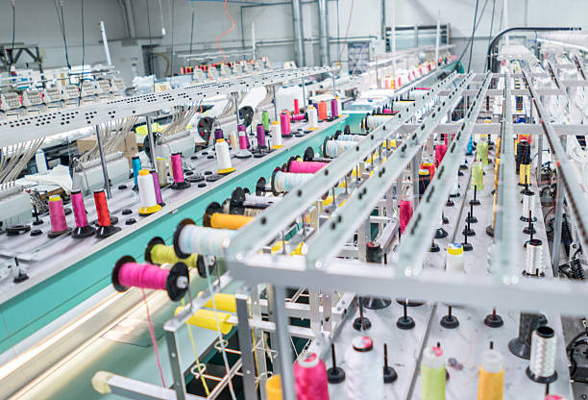
2. Textile Industry:
The textile industry is a major employer and contributes significantly to exports.
It includes spinning, weaving, dyeing, and garment manufacturing.
Textiles are one of Pakistan's primary industries.
Textile and clothing exports account for over 61% of Pakistan's total exports and the industry provides direct employment for about 40% of the country's total industrial workforce.
Example: The Faisalabad Textile City is a major industrial estate in Pakistan, housing numerous textile mills and garment factories

Slide 7

3. Manufacturing:
Pakistan has a growing manufacturing sector.
Industries include automobiles, electronics, pharmaceuticals, chemicals, cement, and steel.
Manufacturing provides employment opportunities across various skill levels.
Manufacturing, value added (% of GDP) in Pakistan was reported at 11.91 % in 2021.
Example: The automobile industry in Karachi produces cars and motorcycles, including popular brands like Suzuki and Honda.

Slide 8

4. Services Sector:
The services sector is a significant contributor to Pakistan's economy.
It includes banking, finance, insurance, telecommunications, information technology, tourism, healthcare, education, and retail.
Services sector jobs offer diverse career options.
Example: Karachi is home to the Pakistan Stock Exchange, one of the largest stock exchanges in South Asia, creating job opportunities in finance and investment.

Slide 9

5. Construction:
Infrastructure development projects have led to a booming construction sector.
Occupations include architects, engineers, laborers, and skilled craftsmen.
Construction plays a vital role in employment generation.
The country's construction industry accounts for 2.53% of Gross Domestic Product (GDP) according to the Pakistan Economic Survey.
Example: The China-Pakistan Economic Corridor (CPEC) has led to the construction of infrastructure projects, such as the Gwadar Port and motorways, providing employment in engineering and construction fields.

Slide 10

6. Transportation:
Pakistan has a well-developed transportation sector.
Occupations include truck drivers, bus drivers, taxi drivers, and railway employees.
The sector supports logistics and facilitates trade and mobility.
The transport and communications sector accounts for about 10.0 percent of the country's GDP.
Example: The Pakistan Railways system connects major cities like Lahore, Karachi, and Islamabad, employing train drivers, station staff, and maintenance crews.

Slide 11

7. Government Services:
The government sector employs a significant number of people.
Occupations range from administrative and clerical roles to technical and professional positions.
Government services provide stability and career opportunities.
Example: The Federal Board of Revenue (FBR) employs tax officials responsible for collecting and managing taxes in Pakistan.

Slide 12
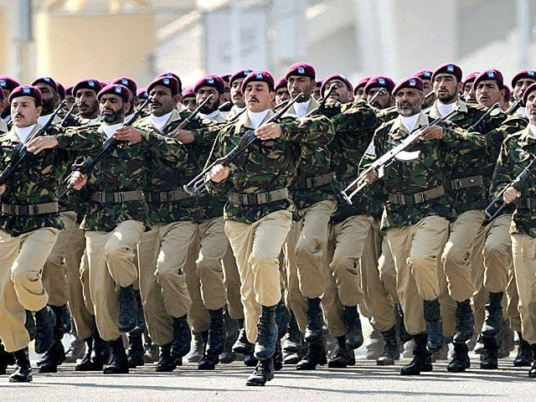
8. Armed Forces:
The Pakistan Armed Forces play a crucial role in national security.
Occupations include Army, Navy, and Air Force personnel.
A career in the military offers discipline, service, and professional development.
Pakistan has announced a 2022–23 defence budget of PKR1. 53 trillion (USD7. 5 billion).
Example: The Pakistan Army recruits individuals who undergo rigorous training and serve in various roles, including combat, logistics, and administration.

Slide 13
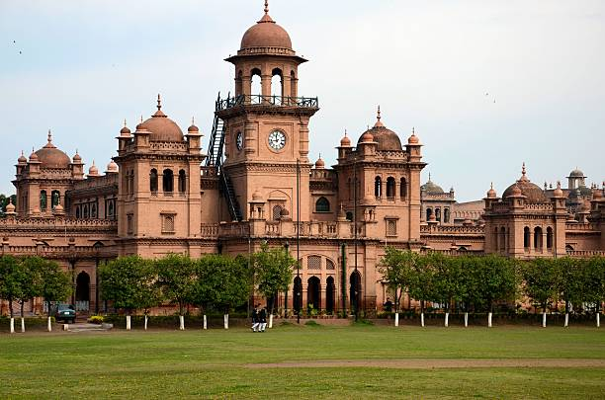
9. Education and Research:
Pakistan has a large education sector.
Occupations include teachers, professors, researchers, and administrative staff.
Education and research contribute to the development of society.
The Economic Survey of Pakistan 2021-22 has pointed out that only 1.77 per cent of GDP was spent on the education sector last year while the literacy rate was recorded at 63pc.
Example: The University of Punjab in Lahore employs professors, researchers, and support staff involved in teaching and conducting academic research.

Slide 14

10. Freelancing and Entrepreneurship:
The digital economy has given rise to freelancing and entrepreneurship.
Occupations include software development, graphic design, content writing, digital marketing, and e-commerce.
These occupations offer flexibility and independence.
Example: Pakistani freelancers provide digital services globally, such as website development, graphic design, and content writing, using platforms like Upwork and Fiverr.

Slide 15
Conclusion:
Pakistan has a diverse range of occupations.
Agriculture, manufacturing, services, and construction are major sectors.
The government, armed forces, education, and freelancing also play significant roles.
Occupations reflect the country's economic landscape and provide employment opportunities for its population.

Slide 16
Thank You
Thank you!

